Slide 1
Decoding Song Popularity on Spotify: An Analytical Approach to Predictive Insights
Understanding factors influencing Spotify song success
-By Abhay Kukade
Notes:
AI-generated content may be incorrect. --- In this presentation, we will delve into the analytical methods used to understand the factors that influence song popularity on Spotify. We aim to uncover predictive insights that can aid artists, producers, and marketers in navigating the music landscape.

Slide 2
Outline of the Presentation
Problem Statement & Objective
Data Overview
Exploratory Data Analysis (EDA)
Artist Influence Analysis
Feature Engineering & Selection
Model Building – Random Forest Regressor
Feature Importance & Insights
Actionable Recommendations
Challenges & Future Work
Notes:
We will begin by outlining the problem statement and objectives of our analysis. Next, we'll provide an overview of the data we used, followed by exploratory data analysis. We will then analyze artist influence, discuss feature engineering, and present our model building process. Finally, we will share our actionable recommendations and discuss challenges and future work.

Slide 3
Problem Statement & Objective
Notes:
Our goal is to identify the key factors that influence Spotify song popularity. We will clean and analyze the data, build predictive models, and ultimately provide actionable insights to recommend trendy songs based on our findings.

Slide 4
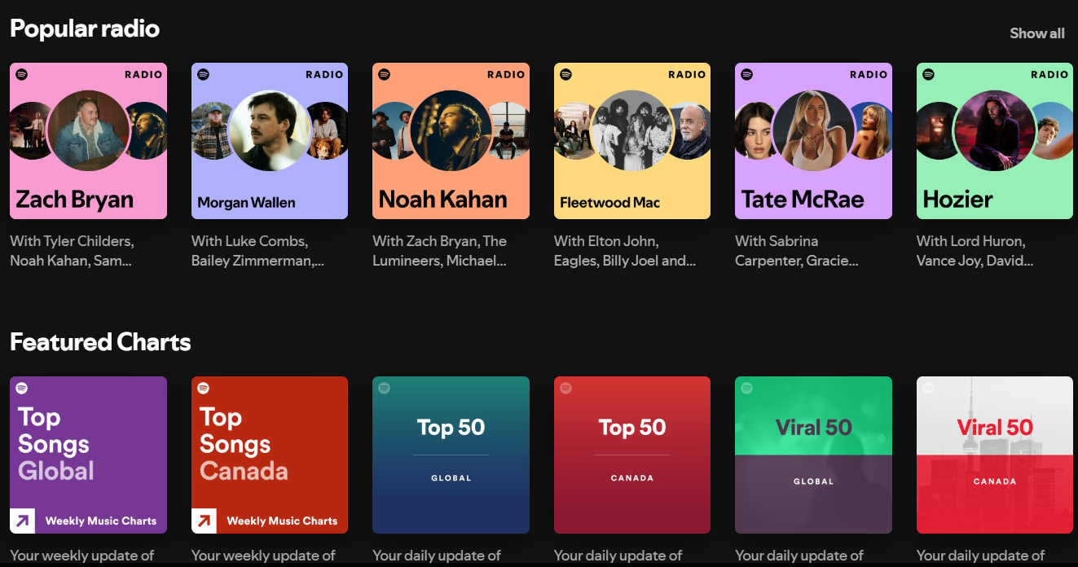
Goal: Identify Key Factors Influencing Spotify Song Popularity
Elements of Popularity
Streams
In Playlists and Charts count
Song Metrics
Acousticness
Valence
Danceability
Artists
Notes:
Understanding the elements that contribute to a song's popularity on Spotify can significantly enhance music production and marketing strategies. By pinpointing these factors, we can help artists achieve greater visibility.

Slide 5
Approach: Clean and Analyze Data, Build Predictive Models
Data Cleaning Process
Thorough data cleaning is essential to ensure the accuracy of the dataset, removing any inconsistencies and errors.
Comprehensive Data Analysis
After cleaning the data, I performed comprehensive analysis to identify trends and patterns that influence song popularity.
Building Predictive Models
I developed predictive models that leverage the analyzed data to forecast song popularity based on key identified factors.
Notes:
Our approach involves thorough data cleaning to ensure accuracy, followed by comprehensive analysis and the development of predictive models that can forecast song popularity based on identified factors.

Slide 6

Outcome: Actionable Insights to Recommend Trendy Songs
Two-Pronged Actionable Insights (Identify songs that are likely to become popular based on data-driven trends and listener preferences)
For New Songs – Using song metadata and its musical properties
For Old Songs – Also using available Charts and Playlists data from other Streaming Platforms
Notes:
The outcome of our analysis will provide actionable insights that can inform recommendations for music producers and marketers to help promote songs that are likely to become popular.

Slide 7
Data Overview
Notes:
In this section, we will discuss the data sources we utilized, the challenges faced with data inconsistencies, and the steps taken to ensure the quality of our data for analysis.

Slide 8
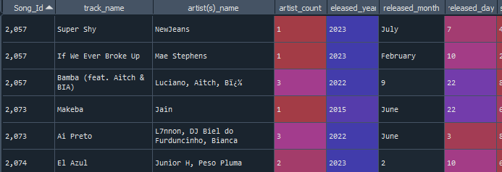
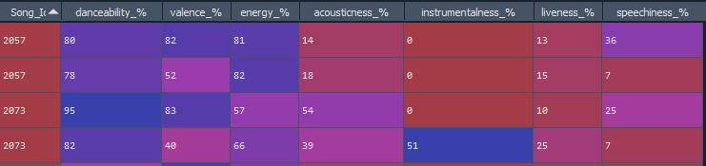
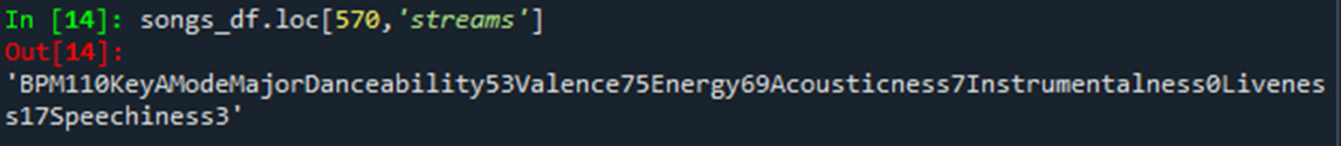
Challenges
Identifying Target and Independent variables
Reasoning whether Playlist and Chart counts should be used as predictors
Duplicated Data Entries
Many Duplicate Song Ids in both the song and node details dataset
Inconsistent Data Formats and Errors
Columns – Song_Id, released_month, released_year, streams
Notes:
We encountered various challenges due to the use of multiple data sources, which led to duplicates and inconsistencies in formats. Addressing these issues was crucial for achieving reliable results.

Slide 9
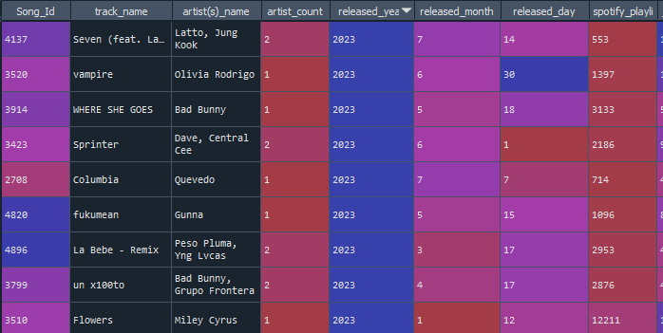
Steps Taken for Data Cleaning and Transformation
Removing Duplicates
The first step in data cleaning was to identify and remove duplicate entries, ensuring each record is unique.
Standardizing Formats
I standardized formats across all data fields, ensuring consistency and accuracy for analysis.
Ensuring Data Integrity
Data integrity checks were implemented to validate the accuracy and reliability of the dataset before analysis.
Notes:
We implemented a series of data cleaning procedures to remove duplicates, standardize formats, and ensure the integrity of the dataset, preparing it for subsequent analysis.

Slide 10
Artist Influence Analysis
Notes:
Analyzing the influence of artists is crucial in understanding song popularity. We will discuss how we handled multi-artist collaborations and assessed their impact.

Slide 11
Aggregated Streams to Get Artist Average Performance
Splitting multi-artist rows enabled to focus on each artist's specific impact on a song.
Ranked artist based on average aggregated streams
Average streams count provide insights into artists' contributions to song popularity and listener engagement.
Created a new feature 'points' by assigning percentile tiers on average streams for the artists
'points' mapped back to each song in the main df
Notes:
By aggregating streaming data, we calculated the average performance of each artist, providing insights into which artists had the most significant impact on song popularity.

Slide 12
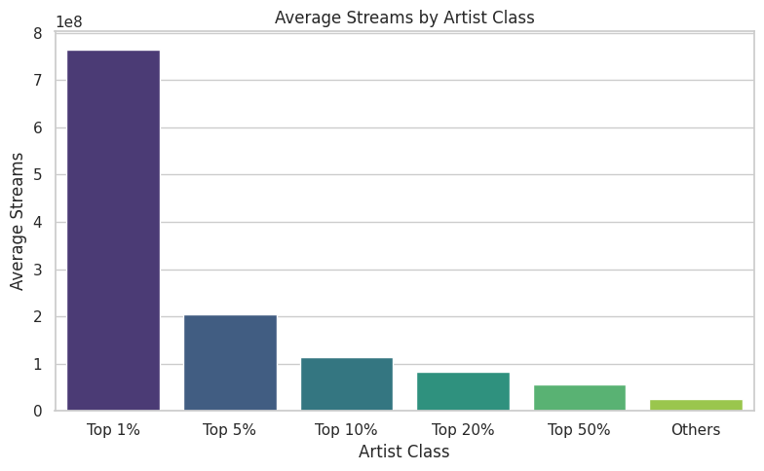
Classified Artists Into Top 5, 10, 20, 50, 100 → Assigned 'Points' To Songs
Artist Classification
Artists are categorized into different tiers based on their streaming performance, which helps to identify top performers.
Points Assignation
Points are assigned to songs based on their streaming performance, reflecting their popularity and influence in the music industry.
Influence Measurement
This classification allows us to gauge the influence of popular artists in shaping musical trends and charts.
Notes:
Artists were categorized into various tiers based on their streaming performance, and points were assigned to songs accordingly. This classification helps us gauge the influence of popular artists.

Slide 13
Exploratory Data Analysis (EDA)
Notes:
Exploratory Data Analysis (EDA) helps us understand data patterns and relationships. We will describe how we visualized correlations and handled missing values.

Slide 14
Identified Missing Values and Imputed Them Using Artist-Wise Medians
Identifying Missing Values
Systematically identified missing values in the dataset, which is critical for maintaining data integrity.
Artist-Wise Medians for Imputation
Using artist-wise medians for imputation allowed to replace missing values while preserving the dataset's overall structure and distribution.
Ensuring Data Robustness
This imputation method ensures that the data remains robust and informative for future analysis and decision-making.
Notes:
We identified missing values in our dataset and employed artist-wise medians for imputation, ensuring that our data remained robust and informative for analysis.

Slide 15
Transformed Skewed Variables Using PowerTransformer
Understanding Skewed Variables
Skewed variables can negatively impact model performance, making transformations essential for better analysis.
Log Transformation
Log transformations are commonly used to reduce skewness and normalize distribution, aiding in model accuracy.
PowerTransformer Utility
PowerTransformers can stabilize variance and make data more Gaussian-like, improving the effectiveness of modeling.
Notes:
To improve the distribution of skewed variables, we applied log transformations and PowerTransformers, ensuring that our features were appropriately scaled for modeling.

Slide 16
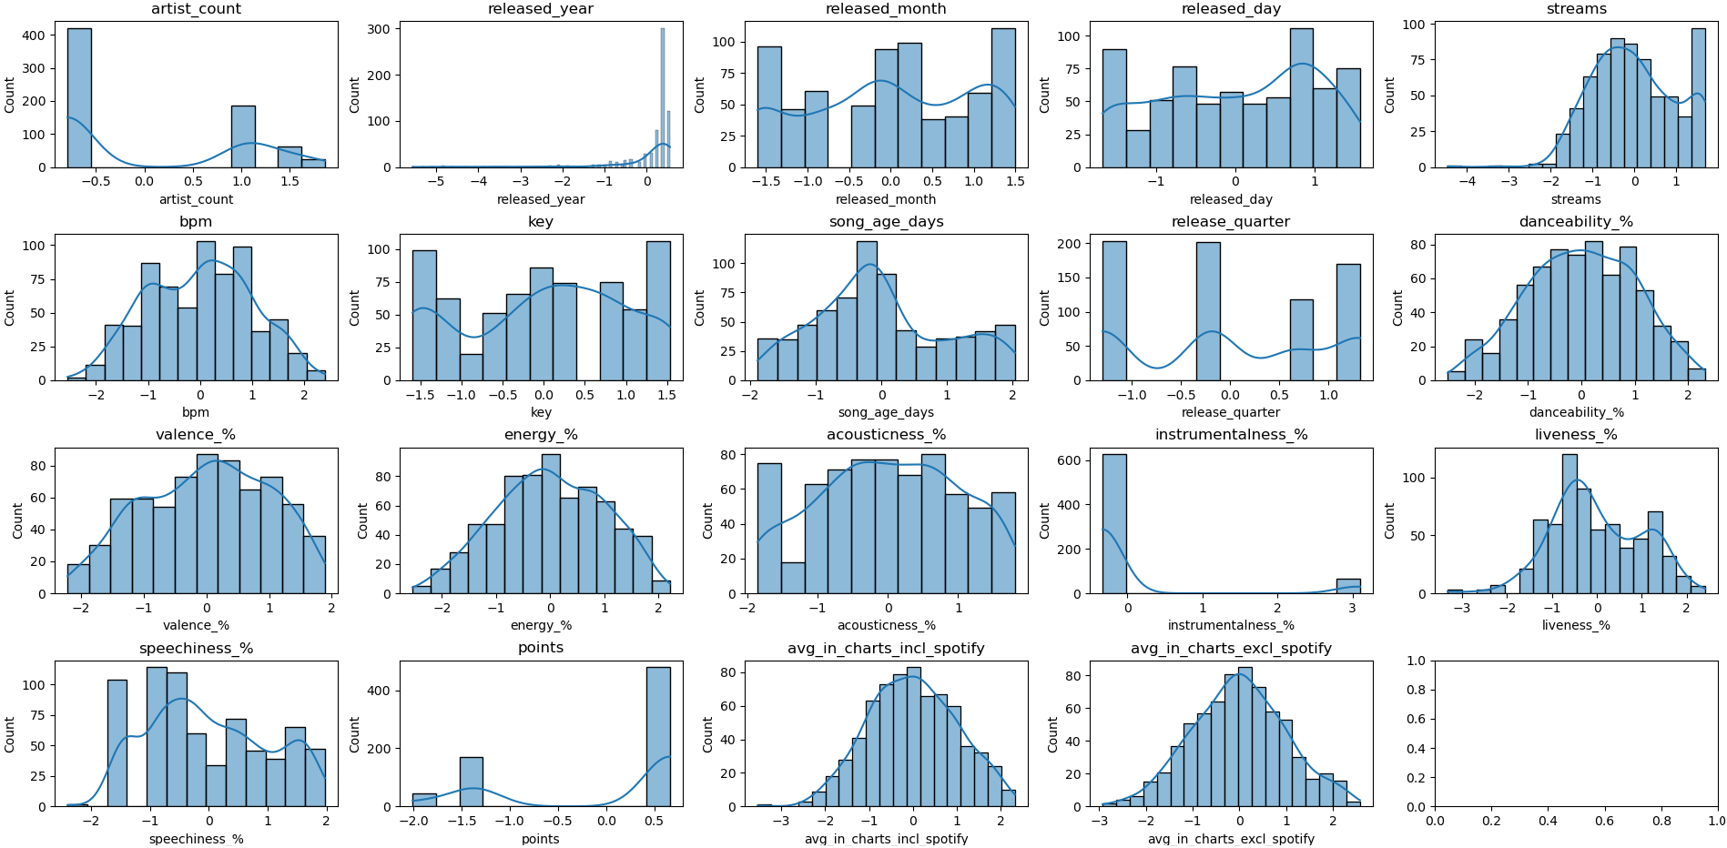
Distribution after Transformation

Slide 17
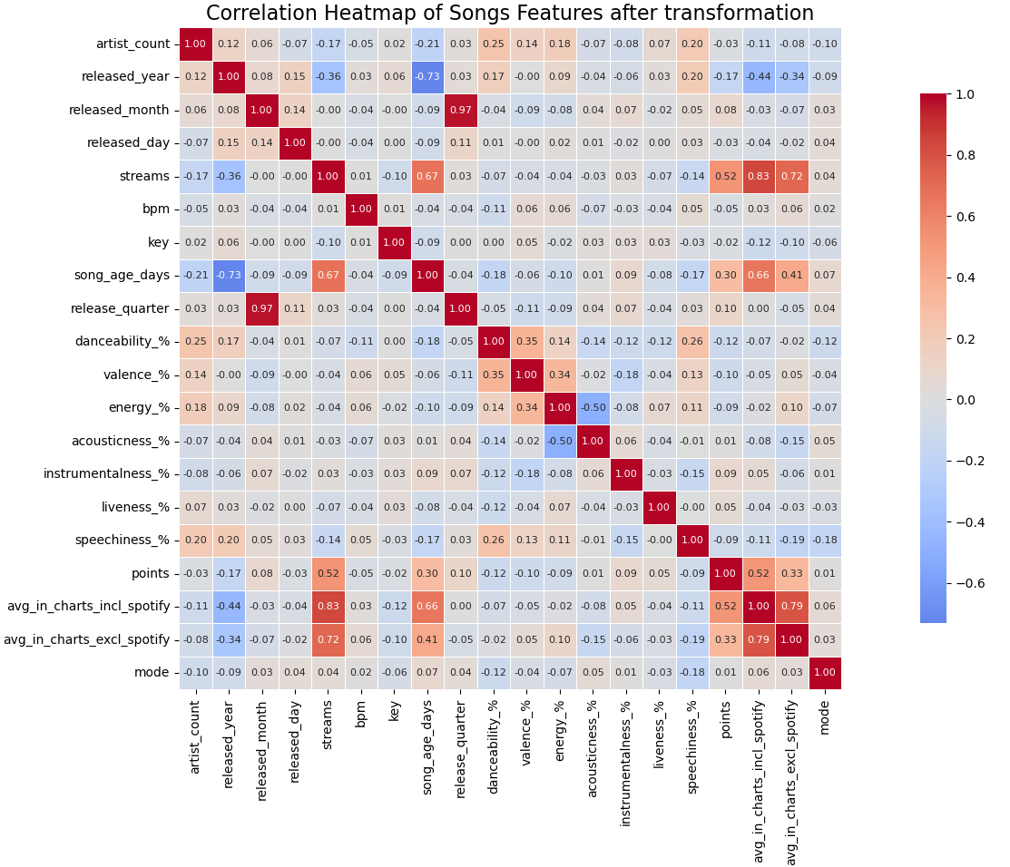
Visualized Correlations via Heatmap
Key Relationships Highlighted
By visualizing correlations, we can identify key relationships that may significantly influence the success of songs.
Guiding Analysis
This visual representation is crucial for guiding our further analysis and decision-making in the study.
Notes:
Using a heatmap, we visualized the correlations among various features, highlighting key relationships that could influence song popularity. This step is vital for guiding our analysis.

Slide 18
Model Building – Random Forest Regressor
Notes:
In this section, we will discuss our choice of model for predicting song popularity and how we optimized it for better performance.

Slide 19
Used GridSearchCV to Tune Hyperparameters
Hyperparameter Tuning
Hyperparameter tuning is essential for improving the performance of machine learning models, including Random Forest Regressor.
GridSearchCV Method
GridSearchCV is a powerful tool that helps in finding the optimal parameters by exhaustively searching through a specified parameter grid.
Random Forest Regressor
The Random Forest Regressor is an ensemble learning method that improves predictive accuracy through multiple decision trees.
Notes:
We employed GridSearchCV to systematically tune hyperparameters for our Random Forest Regressor, ensuring that our model achieved the best possible performance.

Slide 20
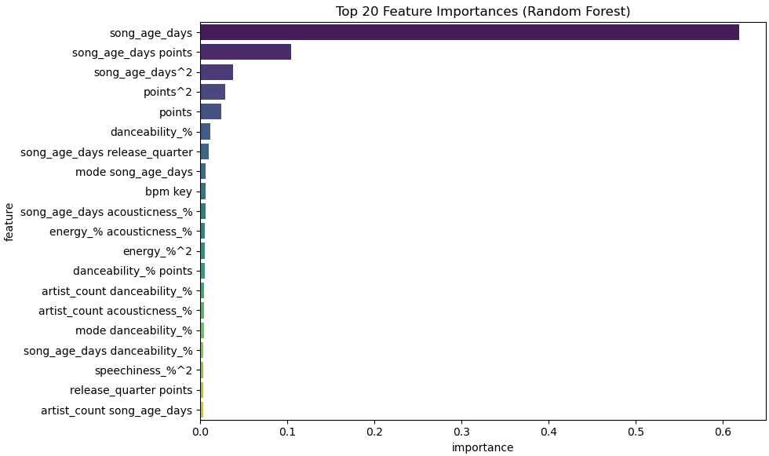
Created Interaction Features
Understanding Danceability
Danceability captures how suitable a track is for dancing, influenced by tempo, rhythm, and structure.
Energy Level in Music
Energy reflects the intensity and activity of a song, affecting its appeal and listener engagement.
Interaction of Features
Exploring interactions, like danceability and energy, helps us understand the overall appeal of a song.
Notes:
We crafted interaction features that explored the relationships between key attributes, such as danceability and energy, to better capture the essence of what makes a song appealing.

Slide 21


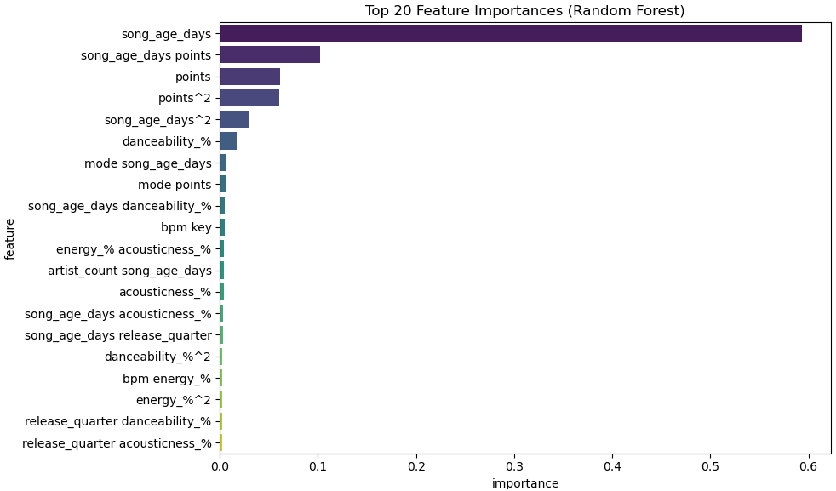

Slide 22
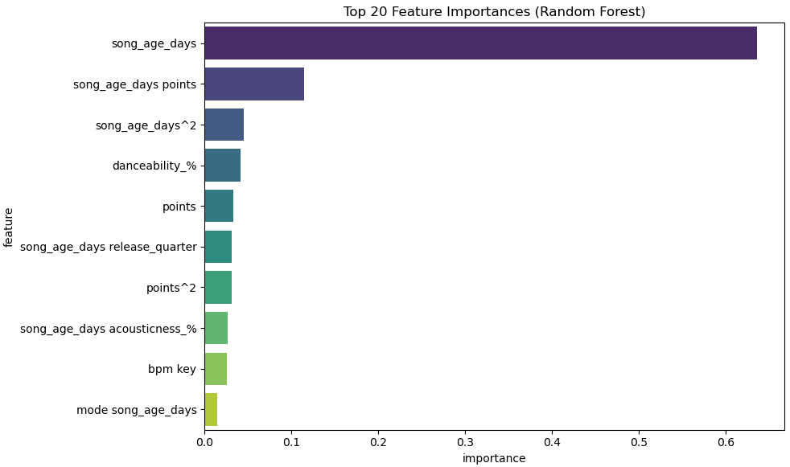
Final Model Trained on Top Features and Engineered Variables
Notes:
The final model was trained using the most relevant features and engineered variables, yielding a robust predictive tool for analyzing song popularity.

Slide 23
Feature Importance & Insights
Notes:
Understanding feature importance is critical in determining what drives song popularity. We will highlight the top predictors and key learnings from our analysis.

Slide 24
Top Predictors
Song Age (song_age_days)
Older songs accumulate more streams over time.
Strongest predictor due to continuous exposure and sharing.
Artist Popularity (points)
Weighted score based on artist’s average stream performance.
Songs by top-tier artists (Top 5 / Top 10) consistently perform better.
Artist Influence × Song Age (song_age_days * points)
Interaction term captures impact of both artist hype and longevity.
Amplifies predictive power when influential artists release newer content.
Danceability (%)
Songs that are easier to dance to tend to go viral and appear on playlists.
High influence on short-form content (Reels, TikTok).
Release Timing (release_quarter)
Seasonality plays a role; strategic releases in Q4 and summer often perform better.
Key & Mode (e.g., Major or Minor)
Subtle correlation with mood/tone of songs.
Minor-key songs trend more during specific periods or genres.
Polynomial Features (e.g., song_age_days², points²)
Capture nonlinear effects and diminishing returns on age/popularity.
Acousticness (%) & BPM
Genre indicators that subtly influence playlist placement and listener retention.
Notes:
Our analysis revealed that the most significant predictors of song popularity include the artist influence score, danceability, energy levels, and the age of the release.

Slide 25
Actionable Recommendations
Notes:
Based on our findings, we will provide actionable strategies for music production, marketing, and playlist curation to optimize song popularity.

Slide 26
Based on Key Learnings
Prioritize recommending older, artist-backed songs in user suggestions
Surface danceable tracks from newer artists to increase early traction
Use release quarter + age to dynamically boost discoverability of seasonal hits
Focus on acoustic long-tails for playlists that cater to mood-based listening
Notes:
Our recommendations will focus on producing music that is danceable and energetic, leveraging influential artists for collaborations, and ensuring strategic placement on playlists to maximize reach.

